Slide 1
Carbon Capture and Storage
What is it and how can it help us?

Slide 2
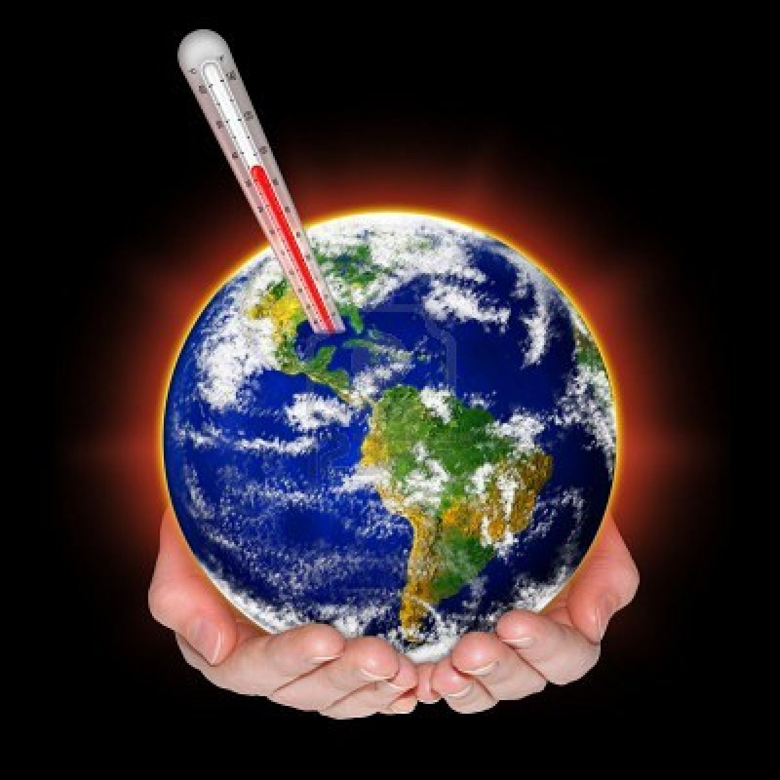
Our world is warming up, and scientists say that people are polluting the Earth by burning fossil fuels. What can we do about it?
First, let’s look at what an atmosphere is and why we need to capture and store carbon.

Slide 3
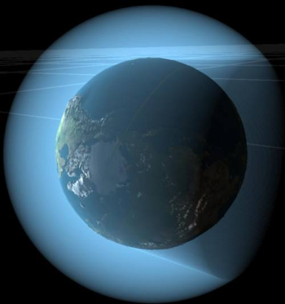
What is an atmosphere?
Our Earth is surrounded by an atmosphere. It is made up of gases: mostly nitrogen, water vapour, CO₂, methane, and nitrous oxide.
The atmosphere acts like a blanket. It traps some heat, and lets some out. This keeps the Earth at a steady temperature of 15°C.

Slide 4

What is CO₂?
CO₂ is natural in the atmosphere, and we need it in small amounts to keep our planet warm. BUT when people cut down trees, mine for metals and minerals, and burn fossil fuels; it adds too much CO₂ to the atmosphere.
+
+
=

Slide 5
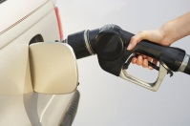
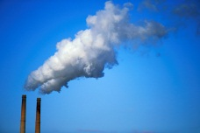
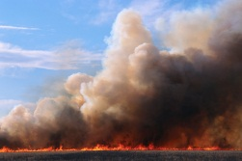
Scientists have found that the biggest cause of CO₂ increase is the burning of fossil fuels. Fossil fuels are things that we burn made from old plants and animals like gas and coal.
This releases CO₂ into the atmosphere.
The CO₂ gets stuck in the atmosphere, and it keeps some heat from escaping the Earth. This is how the Earth heats up.
The carbon cycle is a natural process on Earth, but all the extra CO₂ is disrupting the cycle.

Slide 6
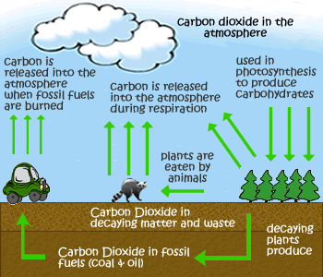
What’s the carbon cycle?
Watch the video on the following slide to find out more about the carbon cycle.
http://www.realtrees4kids.org/sixeight/cycles.htm

Slide 7
http://www.youtube.com/watch?v=2Jp1D1dzxj8 (3:04)
http://www.youtube.com/watch?v=2Jp1D1dzxj8 (3:04)

Slide 8
Why worry about global warming?
We need to do something about global warming because an increased temperature in the world can have the following effects:
  More extreme weather like tornadoes and hurricanes
  Worsened smog causing higher rates of asthma
  Increased spread of disease
  Droughts

Slide 9
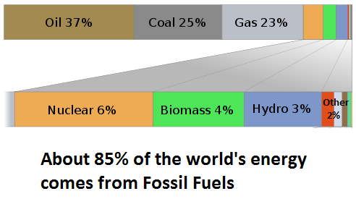
How do we use fossil fuels?
    Using a computer
    Driving a car
    Heating homes
    Turning on lights

Slide 10
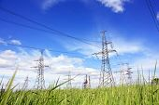
How much do we use fossil fuels?
65% of Saskatchewan’s electricity comes from coal.
Saskpower says that there are over 300 years of coal reserves in Saskatchewan.

Slide 11
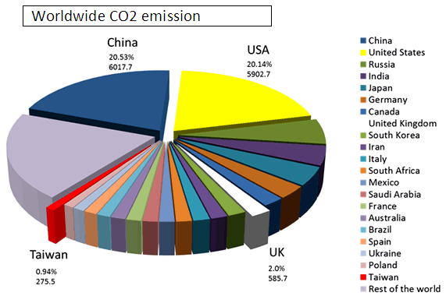
How much CO₂ do we make?
Canada

Slide 12
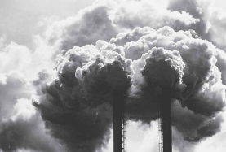
What does that look like?
In 2010, Canada produced 692 000 000 tonnes of CO₂.
1tonne of CO₂ takes up 556.2 m³.
Canada’s surface area is 9 984 670 km²
        So…..
In 2010, Canadians produced a blanket of CO₂ that was 3.86 cm thick over all of Canada!!!

Slide 13
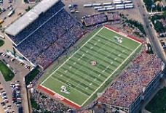
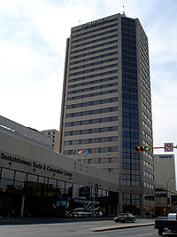
What about Saskatchewan?
Saskatchewan produced 72 100 000 tons of CO₂ in 2010.
This is enough to build a skyscraper of CO₂ with a base the size of Taylor Field. That skyscraper would be over 4000km high!
The tallest building in Regina is the Delta Hotel, and it’s only 83.8 m high!
That’s a lot of CO₂!!!

Slide 14
Now that we know how much Carbon Dioxide we produce by burning fossil fuels, the real question is…

Slide 15
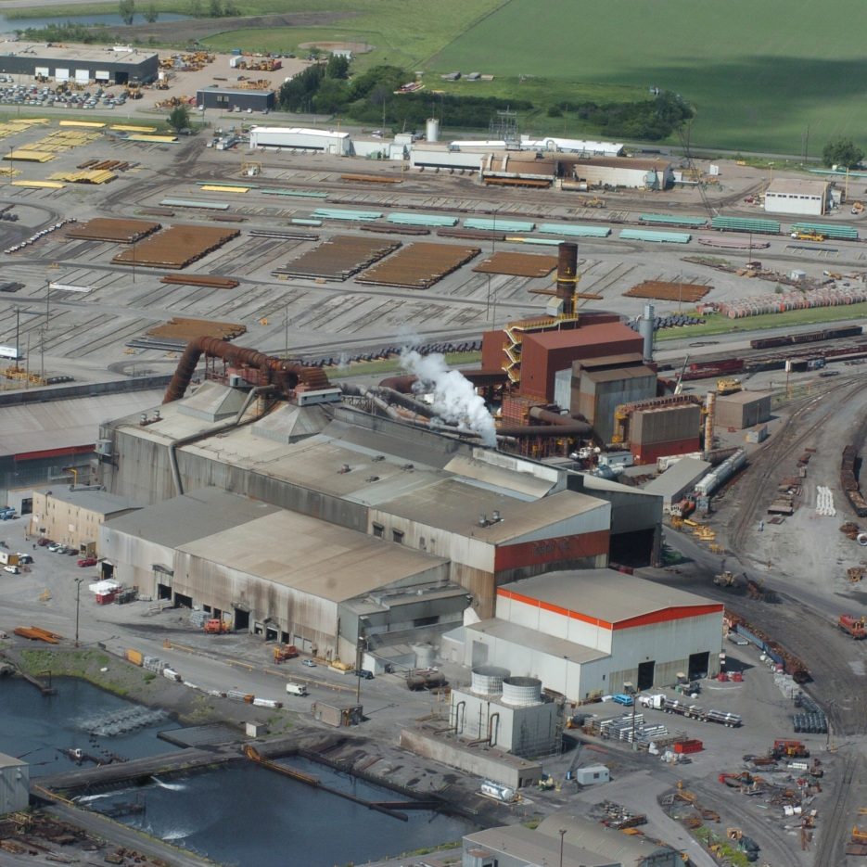
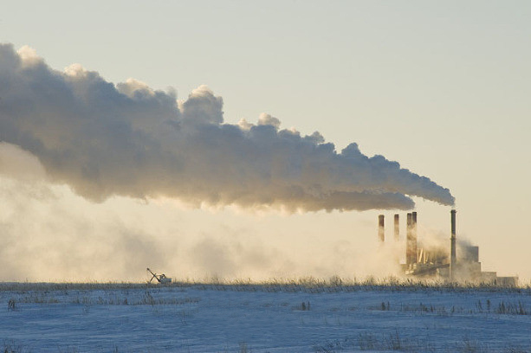
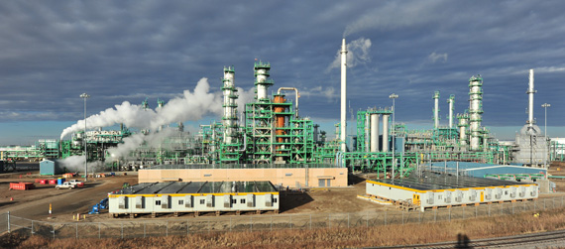
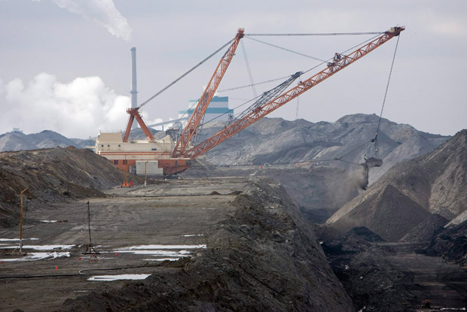
Is CO₂ a waste or a resource?

Slide 16
It must be a waste..
All of that CO₂ used to go up into our atmosphere and pollute our air…
Coop Refinery
http://ccednet-rcdec.ca/en/node/11295
Boundary Dam
www.agefotostock.com

Slide 17
How could it be a resource?
Using CCS, we can take all that pollution, and turn it into something useful!
Once the CO₂ is captured and liquefied, it can be sold to oil and gas companies.
$$$
They inject the CO₂ into a well that still has oil or gas, but not enough pressure to pump it out.
The CO₂ pushes out the last bits of oil and gas from the well.

Slide 18
What is CCS?
CCS or Carbon Capture and Storage is when the CO₂ is captured after it is released when coal is burned.
It is pressurized into liquid form.
Then it gets piped deep underground.

Slide 19
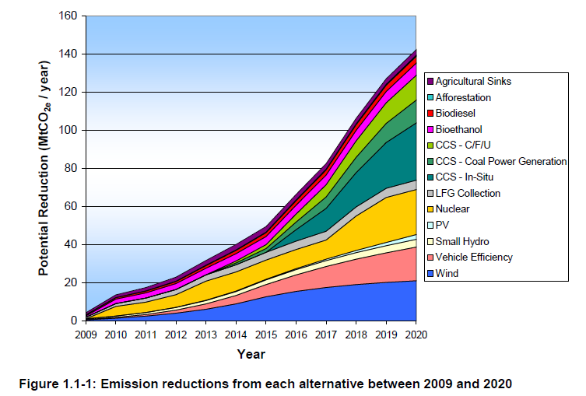
CCS to the rescue!!!
Many scientists say that Carbon Capture and Storage technology will be the best way to reduce large amounts of CO₂ emissions in the next 40 years.

Slide 20
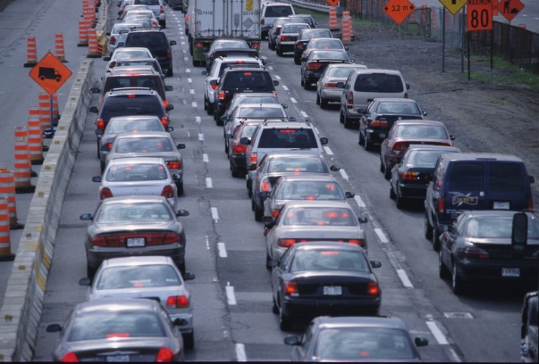
How much can CCS help?
The Saskpower Boundary Dam is being rebuilt with Carbon Capture and Storage technology.
It will reduce emissions to that facility by 90%. That’s the same as taking 250 000 cars off the road!!!

Slide 21
How does the storage of CO₂ work?
Watch the video on the following slide to find out.

Slide 22
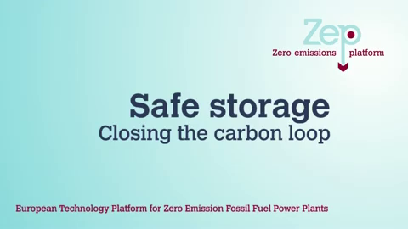
  http://www.youtube.com/watch?v=GglSLuWP5cM

Slide 23
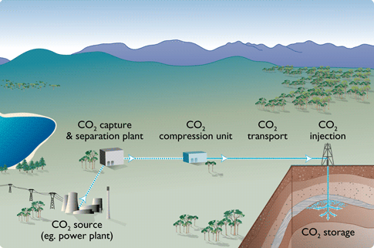
CO2 Capture Visual - http://www.ipac-co2.com/about-co2-storage/how-ccs-works

Slide 24
Where does the CO₂ go?
It needs to go deep underground into a stable formation.
It can’t be stored near the edges of plate tectonics.
It sometimes get stored in old oil fields. It needs to be deep enough and sealed properly so that the CO₂ doesn’t escape.

Slide 25
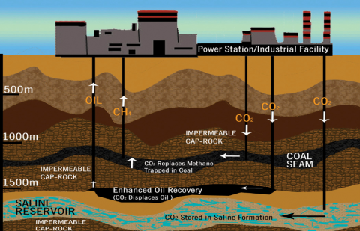

Slide 26



Where do they use CCS?
There are over 100 facilities worldwide that use CCS.
Where | Tonnes of carbon stored per year
Snohvit, Norway | 700 000
Sleipner, Norway | 1 000 000
Salah, Nigeria | 1 200 000
Oklahoma, United States | 680 000
=
100 000 tonnes of Carbon

Slide 27
Do we use CCS in Canada?
Where? | Tonnes of carbon that will be stored per year | When?
Weyburn, Sask. | 2 000 000 | 2010
Boundary Dam in Southern Sask. | 1 000 000 | 2014
Quest in Central Alberta | 1 200 000 | 2015
Agrium and Enhance in Central Alberta | 580 000 | 2014
Lloydminster, Alberta | 100 000 | 2012

Slide 28
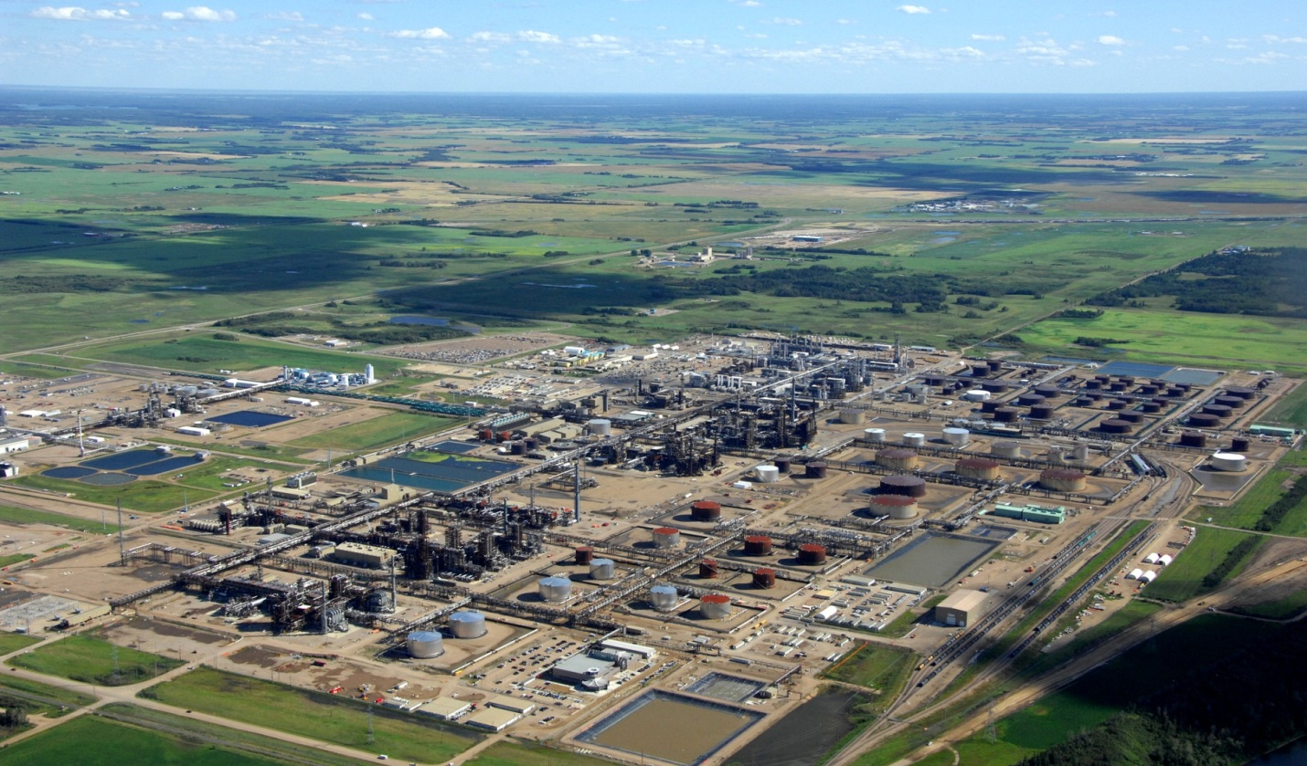
Quest Carbon Capture and Storage project in Alberta

Slide 29
CCS is an important part of the solution
The IEA (International Energy Association) estimates that a 50% decrease in CO₂ emissions will still cause an increase of 2-3°C in global temperatures.

Slide 30

If we used CCS, the amount of CO₂ avoided would equal:
Planting 62 000 000 trees and waiting 10 years for them to grow
Cutting electricity emissions from 300 000 homes
                Environmental Protection Agency

Slide 31

Let’s take care of the Earth…
“We don’t inherit the Earth from our ancestors; we borrow it from our children.”
        David Brower

